Slide 1
INTRUSION DETECTION ALARM SYSTEM ALERT
NAME : GILBERT KIPKEMOI KIPTALAM
REG NO. : COM/040/17
PROGRAMME: COMPUTER SCIENCE

Slide 2
CHAPTER ONE: INTRODUCTION
The system detects intrusion using motion sensor controlled by Arduino microcontroller and alerts the owner.
The system also switches on light automatically when motion is detected and also alarm.

Slide 3
PROBLEM STATEMENT
Cases of theft and intrusions to security sensitive areas have in the past caused panic among property owners. It has therefore led to the emergence of various methods such as deployment of CCTVs, security personnel among others. These methods have helped to curb these cases but not to the best extend
With the increasing trend of intrusion or breaking into premises, there has been increased theft and damaging of the property and others being stolen. Also sometimes, intruders may cause harm to the people in the household which may include even lead to the death of the people. To reduce such occurrences there is need to implement home intrusion detection method using motion detection with alarm alert.

Slide 4
Objectives
To reduce home intrusion and burglary by detecting intrusions and notifying the owners in real time through alarm.
To detect intrusions and burglary at homes and notify owners through alarm.
To set alarm on automatically in presence of intrusion to alert inhabitants about intrusion.
To switch on lights automatically to scare away intruders at night.

Slide 5
JUSTIFICATION
Security of private and personal property is still a challenge. In the growing world of technology, burglars have deduced methods that keep on changing with time.
It was therefore necessary to create a unit that can monitor real-time user authentication of people accessing certain premises.
The system will ensure that all people accessing areas of interest are permitted thus enhancing security of such areas.

Slide 6
SCOPE
The geographic scope of this research is limited to a personal property (house, apartment and office).
The design and execution scope of this research is confined to designing and building a comprehensive, low-cost home control system using a mobile application that communicates with the nodemcu microcontroller and use actuators connected to its input/output pins to control its peripherals.
Further, the research seeks to assemble an electronic board that contains circuits which is responsible for a certain function in the door control system, and each of which communicates with the nodemcu microcontroller.

Slide 7
CHAPTER TWO:LITERATURE REVIEW
An intrusion detection system basically includes CCTV/webcam, alarms, SMS and various sensors. Different technologies have advanced over the years in the monitoring, detection and control of security systems.
These ranges from systems that allow compactible products to communicate with each other through wired connections to wireless connections.
Wireless intrusion security systems today can easily control the home or office mechanical systems and applications over cellular phone or internet. GSM technology nowadays provides a viable ubiquitous access to most systems security and control.

Slide 8
REQUIREMENT ANALYSIS AND SPECIFICATION
The functional requirement for the system.
The system should detect an intruder.
when the system detects motion, it should switch on the lights and alarm and also alerting him/her about the entrances.
The system allows the user to control the activation of the alarm and lights.

Slide 9
SYSTEM DESIGN
The system design will consist;
Microcontroller to control sensors and actuators.
Infrared motion sensor/ultrasonic sensor to detect present of an intruder and activate the actuators LED and Buzzer.
Buzzer to scare away intruder and alert the owner

Slide 10
ANALYSIS AND DESIGN
Hardware requirement;
Arduino microcontroller
Infrared sensor
LED
Buzzer
Breadboards
Cables and connectors
Software requirements;
Arduino compiler

Slide 11
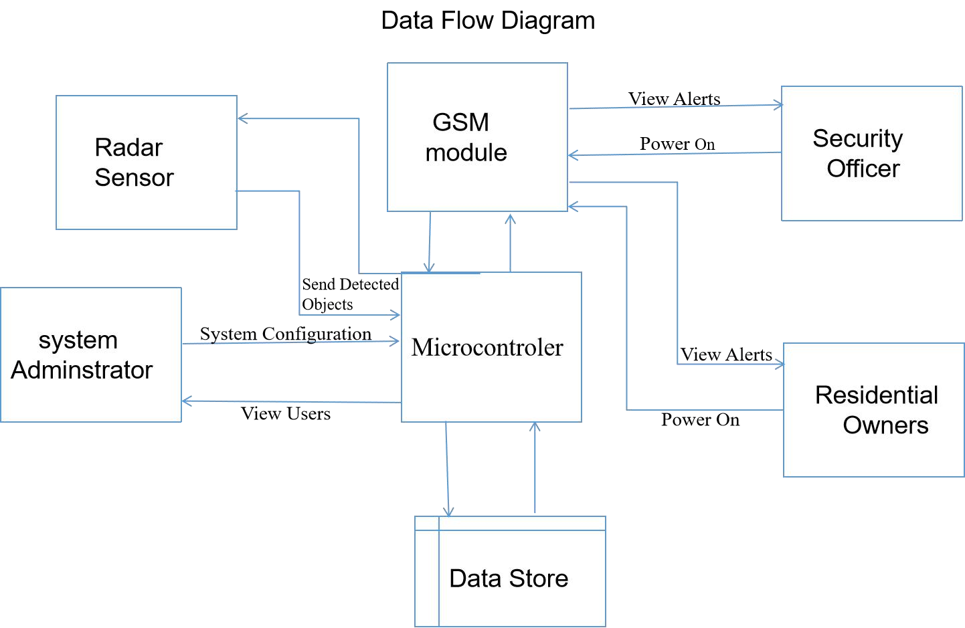
ANALYSIS AND DESIGN (CONT’) Data flow diagram

Slide 12
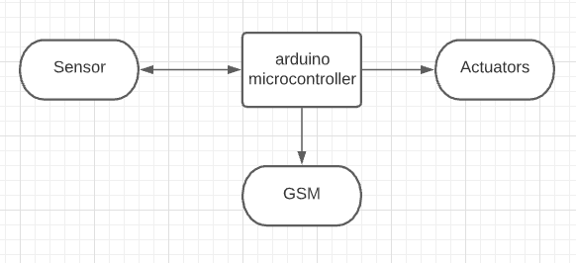
ANALYSIS AND DESIGN (CONT’) Context Diagram

Slide 13
LIMITATIONS
Cannot differentiate between the intruder and the owner. Thus the home owner will have to switch off the alarm whenever is around the property to avoid unnecessary notification and alarms.

Slide 14
RECOMMENDATIONS
In addition to the unfinished requirements, there are other possibilities of further improving the project. The respondent of user acceptance testing also suggest some improvement ideas. The improvements may include:
Adding gas leakage detector and fire detector to the system.
GSM module to send sms
If the alarm sensors detect a problem, the system will alert the home owner through SMS while also sending out an audible alarm to anyone in the home. This can give you the time to get out of the house, while emergency services are on the way.

Slide 15
CONCLUSION
In this project we have implemented a very reliable and efficient system for home and property owners. This project provides simple and user friendly way for intrusion/burglary detection and notification. Other than being simple and user friendly it also reduces the cost of upholding home security by big percentage.
The system will help deter criminal activity. The mere presence of a home security system will deter many perpetrators from doing criminal acts. They do not want to increase the chances they will get caught by the homeowner or by the police in the act.
Intrusion alarm systems protect property and valuables. A home security system is a first line of defense for keeping your property and valuables safe. Vandals are less likely to do damage to your property if there is a chance of being caught. An alarm system can alert police if something bad is going down, which keeps both your property and your valuables safer.
The design system provides a low cost convenient and easy to use system for home security. Intrusion alarm systems reduce worry and stress. When you know that you, your family, and your home are safe, it helps alleviate worry and stress. You get a little peace of mind knowing that someone is watching your home, even when you are not there.

Slide 16
END
Thank you

